Slide 1
EDA CASE STUDY SUBMISSION
Group Name:
Ravindra Vikram Singh
Rituj Srivastava
Ruchita Gupta
Sanchit Thareja

Slide 2
Business objective and problem statement
Background:
The company under consideration is a consumer finance company operating in online loan marketplace
It facilitating personal loans, business loans, and financing of medical procedures
There are risks associated with the company’s decision on loan approval:
Not approving the loan for an applicant, who is likely to repay the loan
Approving loan for an applicant, who is not likely to repay the loan
Problem statement:
This risk of financial loss (credit loss) is largely due to borrowers who default (“charged-off”)
Business Objective:
To understand the driving factors which are strong indicators of loan default & minimize credit loss, which can be utilized for portfolio and risk assessment

Slide 3
Goal of data analysis and approach
Goal of Data analysis:
To analyze the complete loan data for all loans issued through the time period 2007 to 2011, clean the data for any quality issues, create new variables, conduct exploratory data analysis to identify variables which indicate if a person is likely to default, which may be used for taking actions such as denying the loan, reducing the amount of loan, lending (to risky applicants) at a higher interest rate, etc.
Step-by-step approach:
Data understanding
Data cleaning
Univariate analysis: Since the analysis has to be done with respect to loan status, univariate analysis done to find the segregation on the columns that have potential to affect the analysis
Outlier treatment for probable columns (where mean median is significantly different) using box plots
Correlation of all numerical variables using Heatmap to remove highly correlated variables, i.e., just keep 1 of the strongly correlated variables
Bivariate analysis to understand the relation of various attributes with loan status to identify the key drivers

Slide 4
Data understanding and key assumptions (1/2)
Original data set contains information about 39,717 applicants who have been issued loans by the company
Various consumer attributes and loan attributes are spread across 111 columns
Loans are broadly classified into the 3 categories based on their status: Fully paid, Current, Charged-off
Post Data cleaning exercise
70 columns dropped for analysis:
54 columns with 100% null values dropped
5 columns with > 5% null values dropped and not relevant for analysis basis understanding from metadata
9 columns with single unique values dropped, as they don’t provide any useful information for analysis
2 columns (‘url’ and ‘title’) removed a there are multiple unique values in these columns and may not throw any meaningful insights
4 columns with < 2% null values neither removed nor imputed as they won’t make significant impact on analysis
Changed the data type to suit our analysis:
date related columns converted into datetime format,
suffixes like ‘months’, ‘years’ removed from ‘term’ and ‘emp_length’
Similarly, “%” suffix removed from ‘int_rate’, ‘dti’, ‘revol_util’ etc.

Slide 5
Data understanding and key assumptions (2/2)
Post Outlier treatment
475 rows have been dropped:
398 rows have been dropped falling in> 99 percentile of annual income
77 rows have been dropped with interest rate > 22.5% (visible in box plot)
Further, 7 columns removed as they are highly correlated with other variables- only 1 of the correlated values have been kept and others removed, as they won't be adding any value to our analysis. This has been established by creating a correlation matrix using Heatmap
Revised data set has 39242 rows and 34 columns
New variables created for ease of analysis:
inc_category as low, medium, high category for annual income of borrower
dti_range as bins for debt-to-income ratio
revol_range as bins for credit utilization ratio
loan_amnt_range as bins for loan amount
int_cat as bins for interest rate

Slide 6
Key findings from Univariate analysis
Consumer attributes
Id and member id : They have unique values and anyone of them can be referred as unique identifier for every row
Grade: Maximum no. of loans issued to applicant’s classified as ‘B’ Grade and minimum in ‘G’ grade. Grading starts with A and ends with G in decreasing order
Employment length: Maximum no. of loans(22%) have been taken by people with more than 10 years in service and second highest is by people who have just started or are not in job
Home ownerhip: Most of the borrowers have their homes on rent or mortgage. Only ~8% own their homes
Public derogatory records/ public bankruptcies records : ~95% of borrowers had 0 public derogatory records
State: CA state took maximum no. of loans followed by NY
Loan attributes
Loan status: ~83% of loans have been fully paid and ~14% are defaulters. Nearly 3% have their loan status as “current” and this has been ignored from loan status analysis in further slides
Term: ~73% of loans have 36 months of term and ~27% have 60 months of term
Verification status: Income was verified for only about 32% of total loans issued. Rest of them were not verified at all or had only source verified
Loan purpose: 46% of loan was taken for debt consolidation followed by credit card settlement

Slide 7
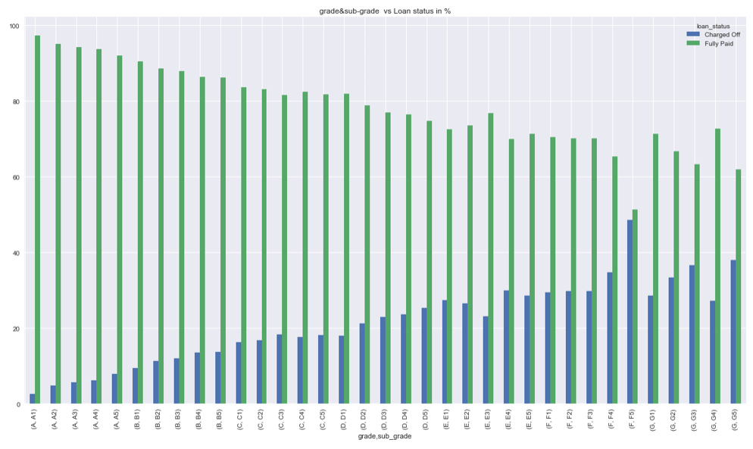

Understanding relationship of loan status with grade- sub grade assigned to borrower by the company (Bivariate)
Loan status has a very strong relation to the grade and subgrade.
As the grade/ subgrade increases the percentage of defaulters (loan status as 'Charged-off' ) also increases.
‘Higher grade classified borrower’ likely to default more

Slide 8
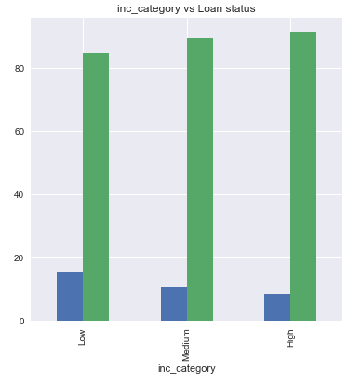
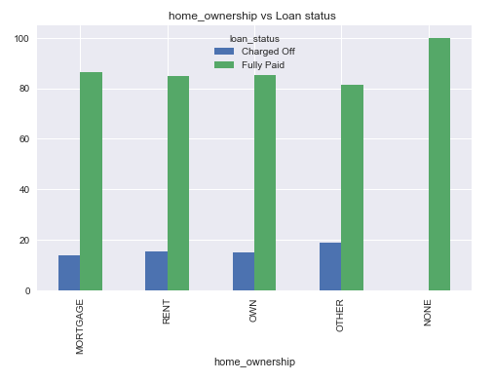
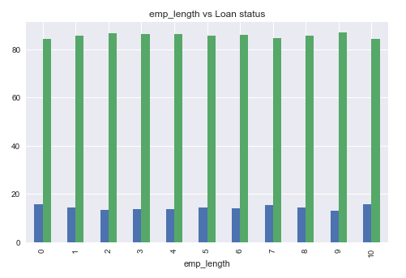
Understanding relationship of loan status with borrower attributes (Bivariate)
As annual income increases from low to high, defaulters % reduces from 15% to 8.6%
‘Low income group’ likely to default more
No significant difference in the % of default loan status on the home ownership
No significant difference in the % of default loan status on the employment length

Slide 9
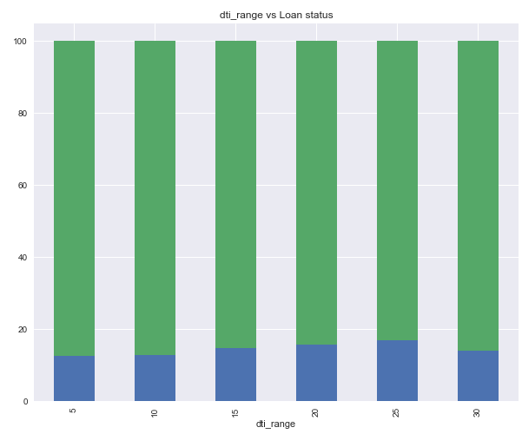
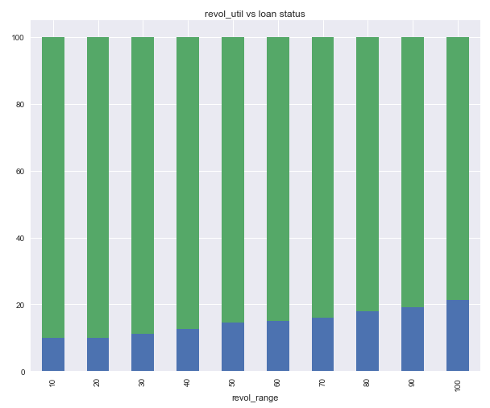
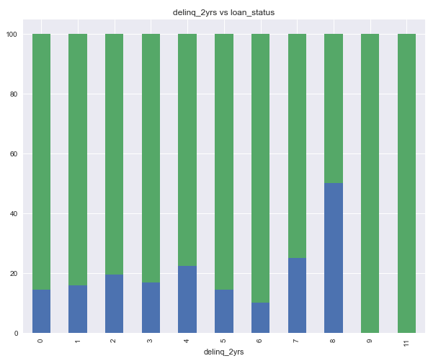
Understanding relationship of loan status with credit history of the borrower (Bivariate) -1/2
Defaulters % increases as dti increases but it decreases between 25-30 %
‘Higher dti slab’ likely to default more
Strong positive correlation between credit utilization% and default %
90-100% revolving credit slab showing 21% default vs. 9.8% in 0-10% slab
‘Higher revolving utilization’ likely to default more
A borrower with 7 -8 number of 30+ days past-due incidences of delinquency in past 2 years is most likely to default

Slide 10
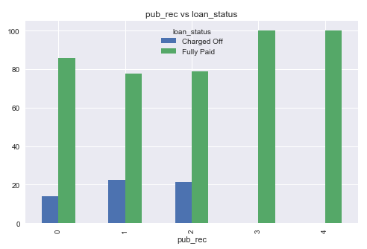
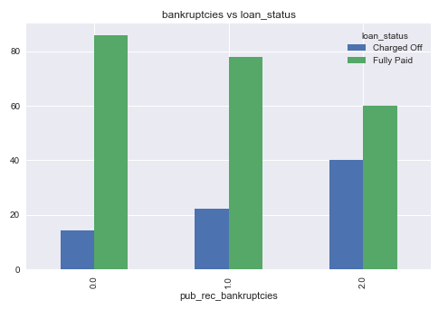
Understanding relationship of loan status with credit history of the borrower (Bivariate) -2/2
Derogatory public records or pub_rec doesn't show consistent relation with loan status
An increase in Public record of bankruptcies witnessing an increase in default %
‘Higher number of public records of bankruptcies’ a likely factor behind default

Slide 11
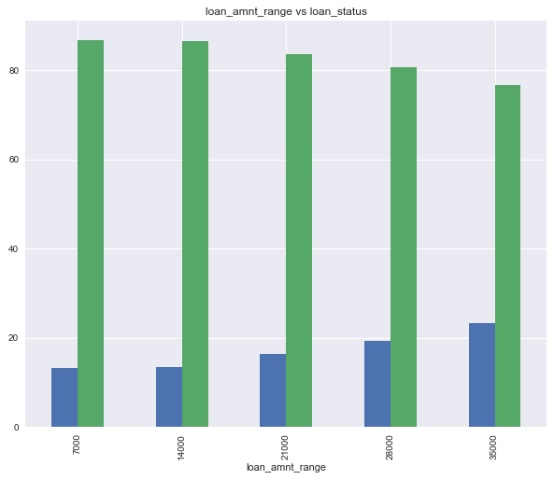
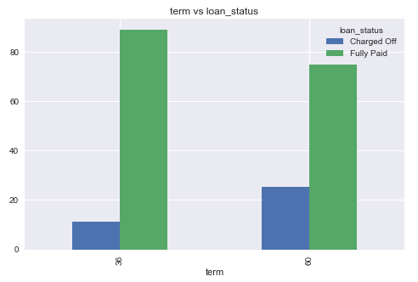
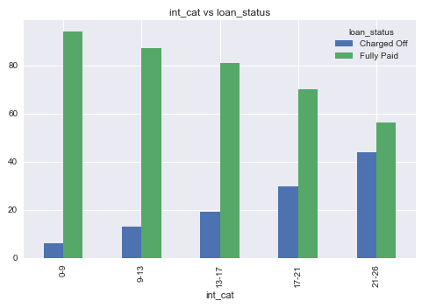
Understanding relationship of loan status with loan attributes (Bivariate)
As the interest rates are increasing, defaulters % also increases
‘Higher interest rate’ is a likely factor behind default
As loan amount increases, defaulters % increases from 13% in the lowest slab to ~23% in the highest slab
‘Higher loan amount’ is a likely factor behind default
There is a higher likelihood of default in a ‘60-month term’ loan vs a ‘36-month term’

Slide 12
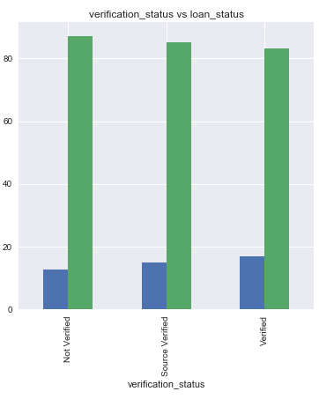
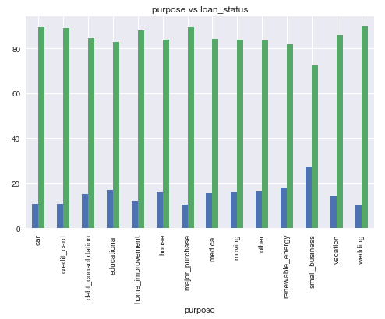
Understanding relationship of loan status with loan attributes (Bivariate)
v
Contrary to the common understanding, highest default % visible for a ‘verified borrower’ compared to compared to ‘not verified’ or ‘source verified’
Top 5 loan purposes, where default is highest: small business, renewable_energy, educational, other, house

Slide 13
Likely indicators to identify borrowers who ‘default’
Based on EDA analysis, following variables* can be said to be influencing the loan status to large extent
Term
loan_amnt
revol_util
Purpose
verification_status
grade & sub-grade*
annual_inc
pub_rec_bankruptcies
Based on these parameters a predictive model can be created which will be able to predict the probability metrics as to whether currently running loans may end up as “Charged Off” or “Fully Paid”
* Interest rate is not considered as a parameter, as it is strongly correlated to grade-sub grade. As grade moves from A to G, interest rate increases. Hence, we have kept only grade-sub grade a s a driver

